Slide 1

Introduction to Pandas
Tabular data and more

Slide 2
Programme: four blocks
Introduction to Series and DataFrames
First operations, reading/writing
Plotting capacities
Timeseries analysis
!

Slide 3
Part I: pandas objects
Series and Dataframes

Slide 4
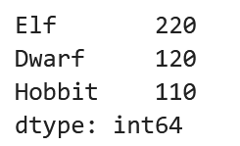
pd.Series: introduction
List of values with indices
Indices of the values
List of values for a given variable
Elf
200
Dwarf
120
Hobbit
110

Slide 5
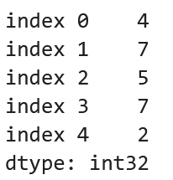
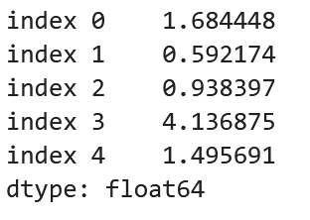
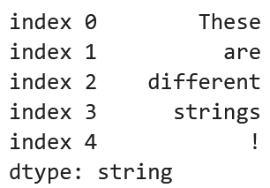
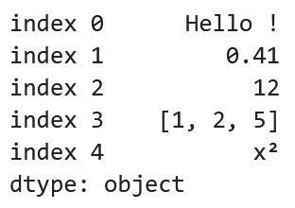
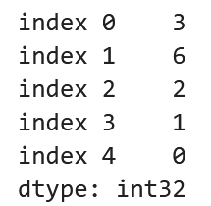
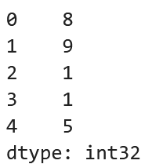
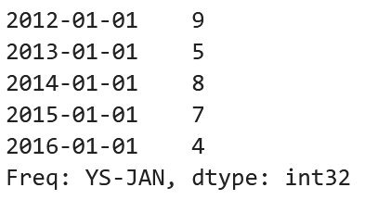
pd.Series: index and data types
Variables can have a type or not
Indices can also have different types

Slide 6
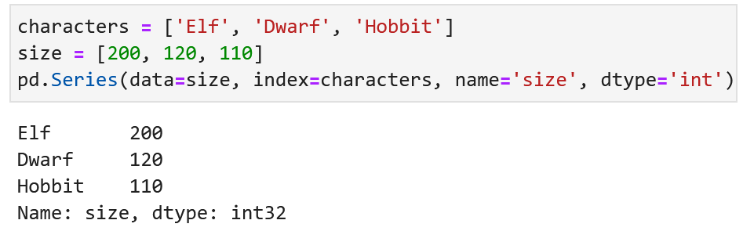
pd.Series: creating an object
Required: a list of values + a list of indices
Use pd.Series()
Required
If not specified: 0,1,2 ,…
Not required

Slide 7
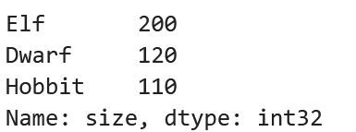
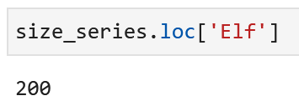
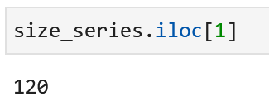
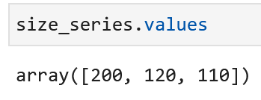
pd.Series: access data
Access data using indices
Access data using position
Access the data as a numpy array

Slide 8
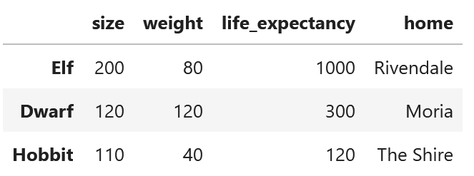
pd.DataFrame: introduction
Multiple pd.Series aligned on the same indices
Each Series has a name
pd.Series
Index

Slide 9
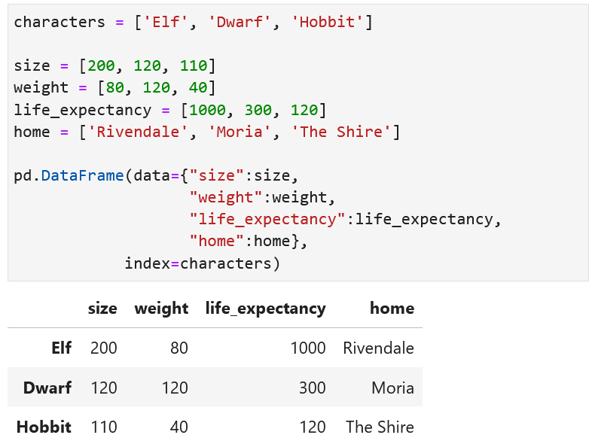
pd.DataFrame: creating an object
Input data:
Object creation:

Slide 10
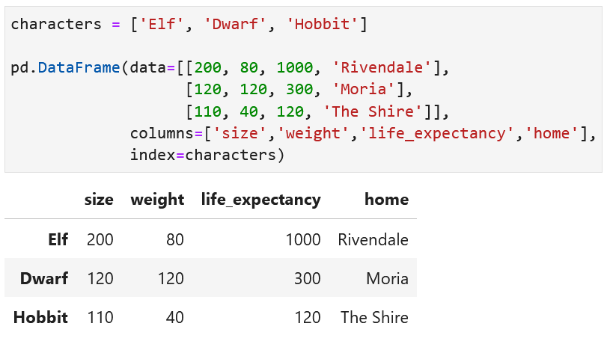
pd.DataFrame: creating an object, option 2
Input data:
Object creation:

Slide 11
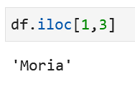
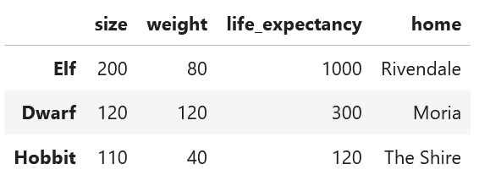
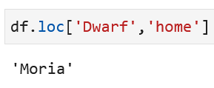
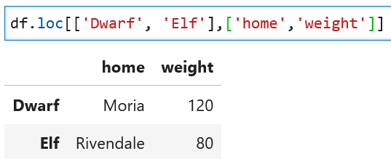
pd.DataFrame: access the data
Select data from index/columns or positions
  Using positions:
  From index/column
  Multiple selection

Slide 12
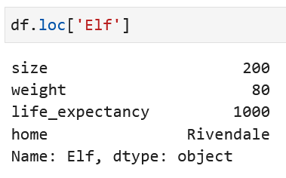
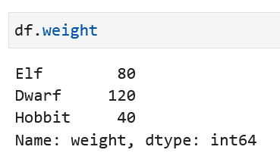

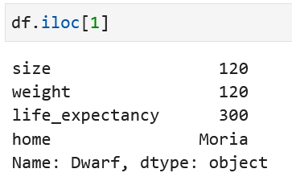
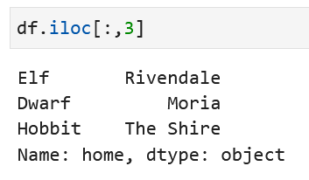
pd.DataFrame: access the data
Access data at one index
  Returns a pd.Series
Access data from one pd.Series
  Returns a pd.Series

Slide 13
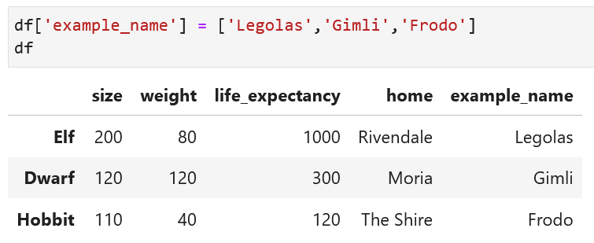
pd.DataFrame: append data
Add a column - pd.Series
  Add the Series as if you want to access the data of a column
The values of the series can also be updated this way.

Slide 14
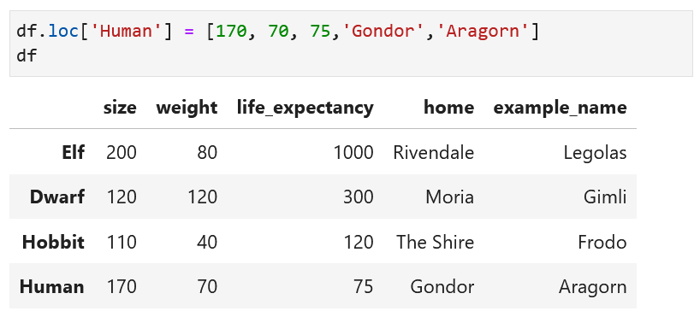
pd.DataFrame: append data
Add a row
  Add the row as if you want to access the data of a line
The values of a line can also be updated this way.

Slide 15
Reading/writing files: supported formats
Pandas supports many tabular-like data formats
  csv
  excel (xls, xlsx) : requiert openpyxl
  txt
  json
  …
Everything that looks like tabular data
Can open directly from internet using url

Slide 16
Reading/writing files: reading
To open a file, use pd.read_format()
Some important arguments
  index_col → columns corresponding to index
  skiprows → skip the first n rows
  nrows → only read the first n rows avec the skipped rows

Slide 17
Reading/writing files: writing
To write a file, use pd.to_format()

Slide 18
Part I: Summary
pd.Series : one variable only
pd.DataFrame : multiple variables aligned
Easy access to data using index values
Objects are flexible and can be modified

Slide 19

Part I: Practicals
Go to the jupyter notebook

Slide 20
Part II: First analyses
Statistical operations, filtering, groups and others

Slide 21
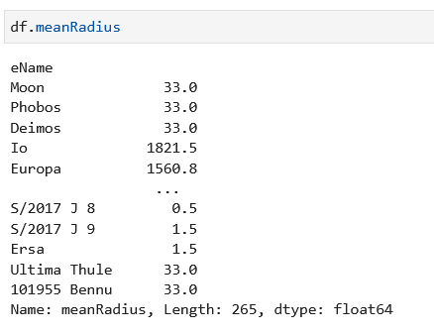
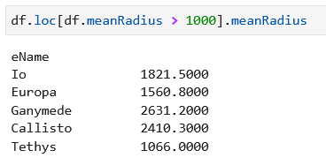
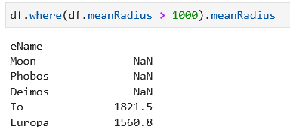

Filter data
Data where mean radius > 1000km?
  Extracting data
  Masking data
Remove rows that contain nans

Slide 22
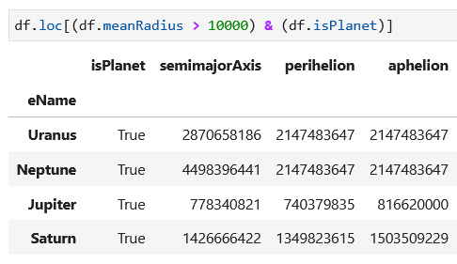
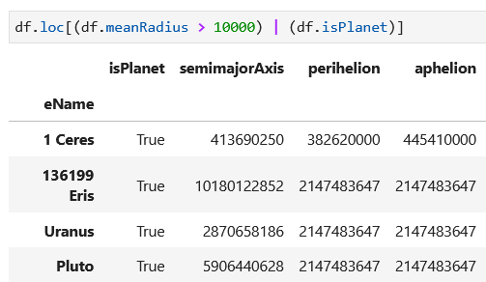
Filter data
Multiconditions:
AND: &
OR: |

Slide 23

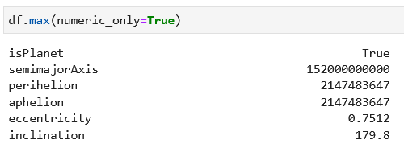

Numpy-like operations: how to
Operation on one series: series.mean()
Operation between aligned series: series1 + series2
Ignores nans by default np.nanmean
Works on Series and Dataframe

Slide 24
Numpy-like operations: examples of existing operations
  mean
  sum()
  min(), max()
  median()
  idxmax(), idxmin()
  quantile([q1,q2, … ])
  count() → non nan values
Statistical operations returning one metric
mean | Mean value | min | Lowest value | max | Highest value | median | Median value
count | Number of non nan values | skew | Skewness of the series | kurt | Kurtosis of the series | mode | Mode of the series
var | Variance of the series | quantile | Find quantiles | sum | Sum all elements in the series | std | Standard deviation
Some operations returning multiple values
rank | Ranks each elements in the series | unique | Returns unique values of elements | cumsum | Cumulative sum of the elemens | cumprod | Cumulative product of the elements
Get location of specific elements
idxmin | Get the index of the minimum value | idxmax | Get the index of the maximum value | argmin | Get the position of the minimum value | argmax | Get the position of the maximum value

Slide 25
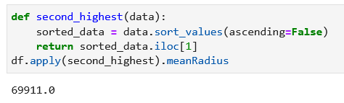
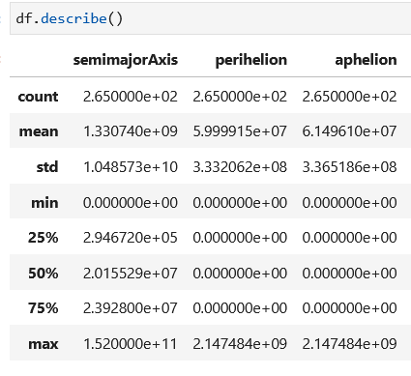
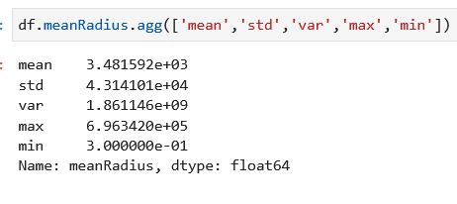
Custom and multiple aggregations
Apply custom function
Implemented describe
Apply multiple functions with agg

Slide 26
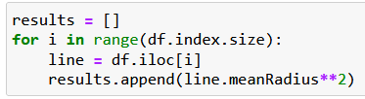

Big warning: no loops !
Many different available operations
Potential to use any custom operation
If your code looks like this …
DON’T!
Do this instead !
1000x faster
There is (almost) always a way to replace a
slow loop by a fast pandas function

Slide 27

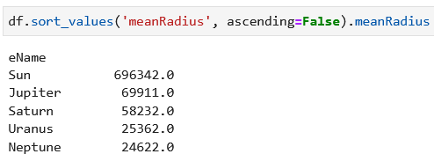
Sorting data
Sort by index:
Sort by one of the columns

Slide 28
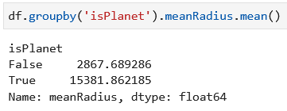
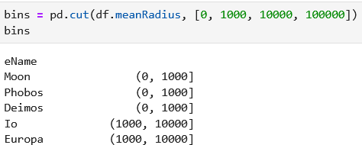

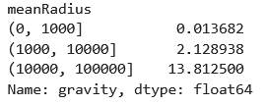
Grouping data using groupby
We can create groups depending on a column and apply operations on each of the groups separatly
Using bins : pd.cut

Slide 29
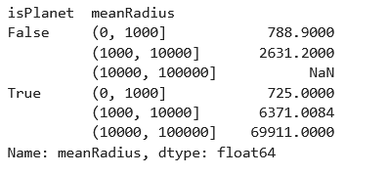
Grouping data using groupby
Multiple criteria

Slide 30
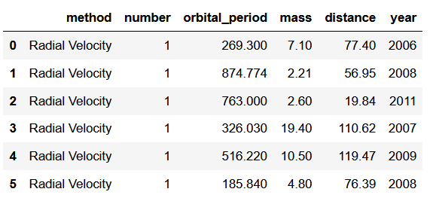
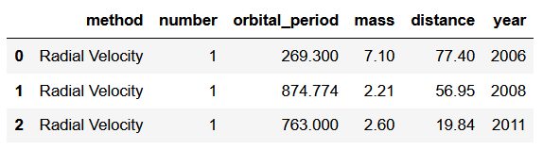
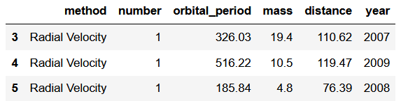
Combining dataframes
Concatenate using the indices
df1
df2

Slide 31

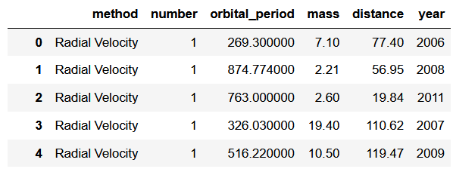
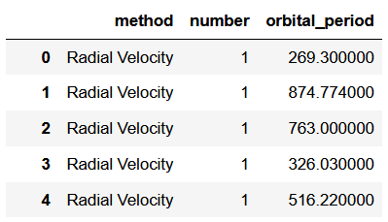
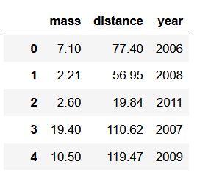
Combining dataframes
Concatenate using columns
df1
df2

Slide 32
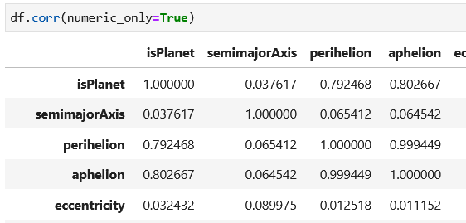
One cool operation
Compute correlation between all variables

Slide 33
Part II summary: first operations
Some of the available methods:
Access data using index/columns + filters
Numpy-like operations
Sort data by index/values
Operations on groups of data
Combine multiple dataframes
Correlation
df.loc[index] df.loc[condition]
df.mean() df.apply(function)
df.agg([‘std’])
df.sort_values() df.sort_index()
df.groupby(columns).mean()
pd.concat([df1, df2])
df.corr()
And so much more …

Slide 34
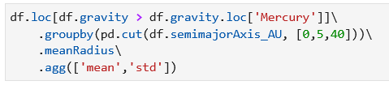
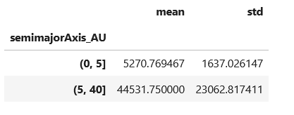
Bonus: « one-liners »
Each method usually returns a new pandas object (Series, DataFrame)
We can keep adding more and more operations

Slide 35
Part II: Practicals
Go to the jupyter notebook

Slide 36
Part III: Plotting
Plotting interface, integration with matplotlib and seaborn

Slide 37


Plotting interface
Direct integration of high level plotting libraries such as matpltolib
Other backends possible (Plotly, bokeh, altair,…)

Slide 38



Plotting statistics for Series
Integrated plotting methods:
series.plot.[type of plot]()
Pandas calls the matplotlib function: same arguments

Slide 39


Plotting categorical data with barplots

Slide 40


Plotting relations between data: scatter/hexbin

Slide 41

Plotting functions available

Slide 42


Integrating within a matplotlib workflow
Setup figure and axes:
Plot with pandas on existing axis:
Change title, labels, limits, etc…

Slide 43


What about seaborn?
Visualization library
optimised for dataframes
Coming soon in the
Atelier numérique de l’OMP

Slide 44
Part III: Practicals
Go to the jupyter notebook

Slide 45
Part IV: Timeseries

Slide 46

Example of data
Series or DataFrame with datetime index
Constant time step or not
Example: temperature logger in the ocean

Slide 47




How to get a datetime index?
Create a new index:
From strings
Frequencies?
  YS, Q, MS, W, D, h, min, s, ms, us, ns
  Can also add a number: 10h

Slide 48

Plot the timeseries

Slide 49



Select data based on time
Use df.loc[time] for specific times

Slide 50


Select data based on time
Use df.loc[time1:time2] for intervals

Slide 51


Resampling
Use the same frequencies as in date_range:
Returns an object that expects an operation
  mean, max, quantile, count, … or apply()

Slide 52


Rolling windows
Keeps the same sampling rate
Returns an object as in groupby: expects an operation
  mean, max, quantile, count, … or apply()

Slide 53



Dealing with missing data
Can we get daily data?
.resample(‘D’).mean()
.interpolate()

Slide 54

Access date information
Many attributes available for a DatetimeIndex
  month, year, dayofweek, is_month_start, is_leap_year, ...

Slide 55

Groupby for temporal data?
Daily temperature cycle:

Slide 56
Part IV summary
series/dataframe with datetime index (numpy datetime/pandas date_range, …)
Some available methods:
df.loc["2012-10-04"]
df.loc["2008-07" : "2015-07"]
df.resample("D").mean()
df.rolling( 5 ).mean() df.rolling( ‘2D’ ).mean()
df.interpolate( )
df.index.hour df.index.day_of_year
Temporal selection:
Period selection:
Resampling:
Rolling windows:
Fill the nans:
Datetime infos:

Slide 57
Part IV: Practicals
Go to the jupyter notebook

